Slide 1
GMM Model
September 2023

Slide 2


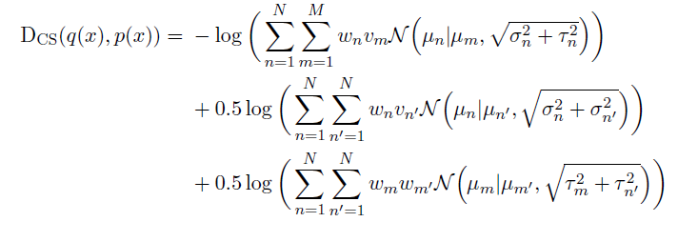
Closed-form Cauchy-Schwarz divergence for mixture of Gaussians
and
Let
be two mixture-of-Gaussian (MoG) distributions with different parameters and different
numbers of mixture components. The Cauchy-Schwarz divergence for a pair of MoGs can
be derived as follows:

Slide 3
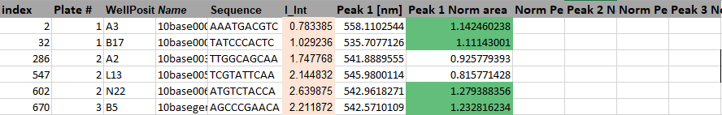
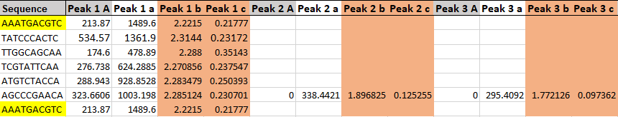

Select a few relatively similar sequences
a🡪 weight
b🡪 mean
C🡪 std.
The weights of GMM must be sum up to one, so we normalized the weights here.

Slide 4
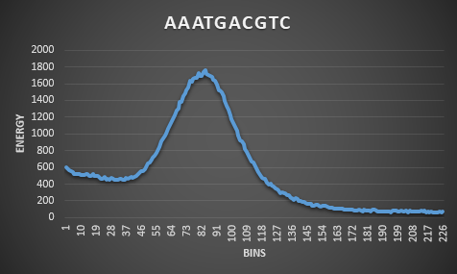
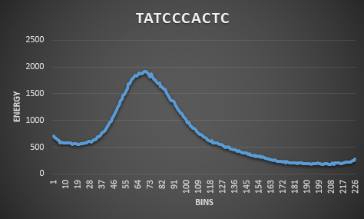
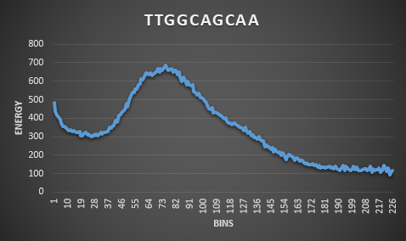
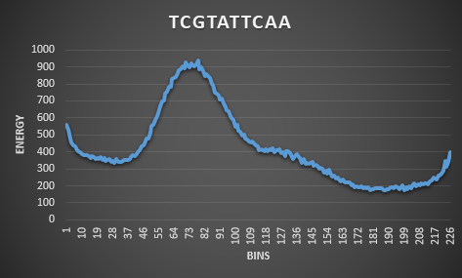
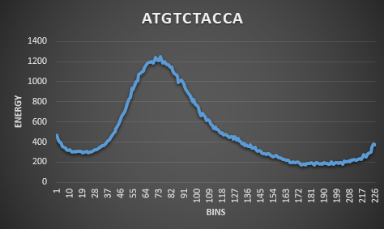
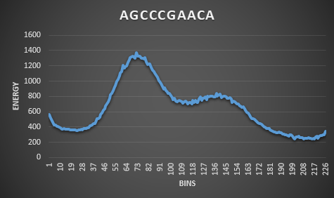
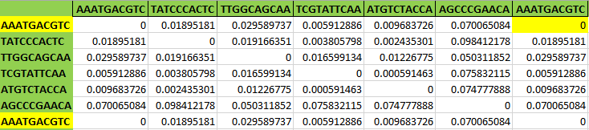
Spectra Visualization & their Distances

Slide 5
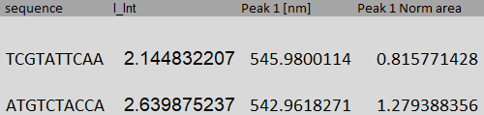
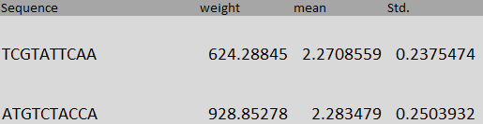
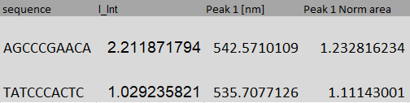
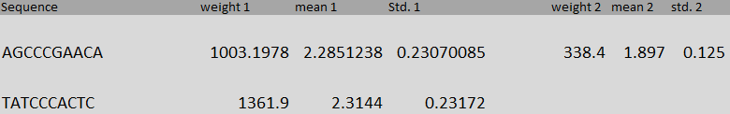
1
Cauchy-Schwarz Distance = 0.000591463
The sequences 1 and 2 are closer in distance. Observing their peaks, they appear to be relatively proximate. Regarding their Gaussians, if we exclude the weights, their means and standard deviations are fairly similar.
2
Cauchy-Schwarz Distance = 0.098412178
Among the selected sequences in Green class, sequences 3 and 4 have the greatest distance from each other. While their peaks and LII are close, sequence 3 is characterized by 2 Gaussians, in contrast to the other one, which only has one.
3
4

Slide 6
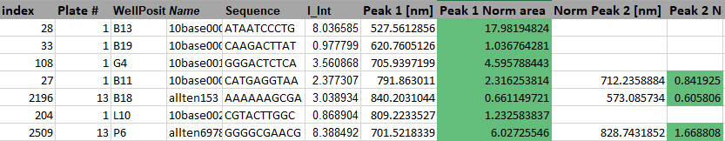
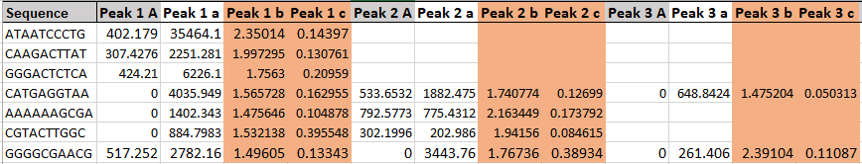
Select a few quite different sequences

Slide 7
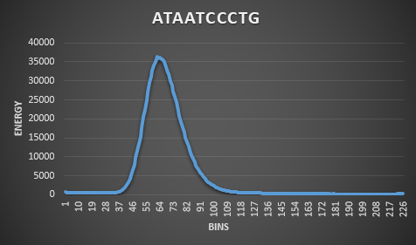
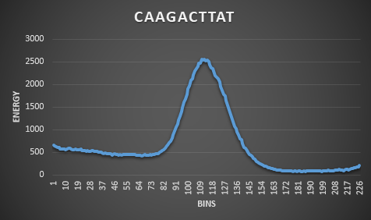
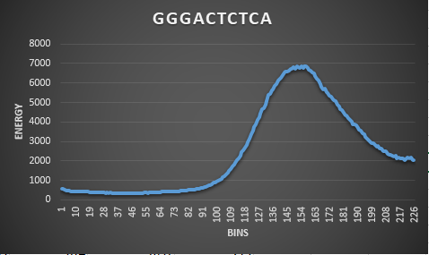
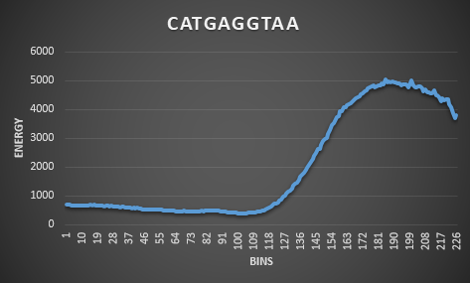
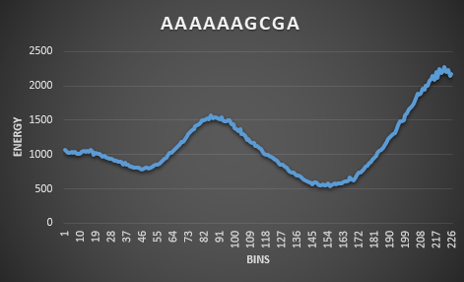
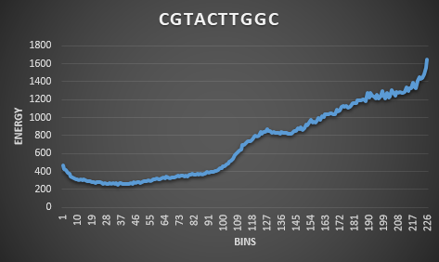
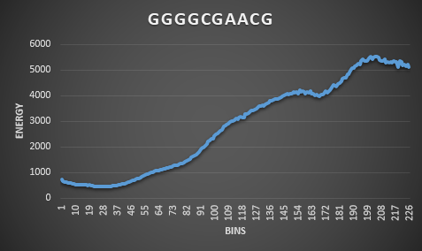
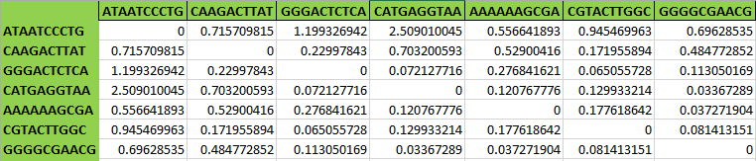
Spectra Visualization & their Distances

Slide 8
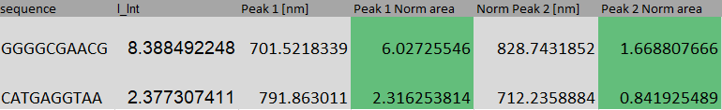
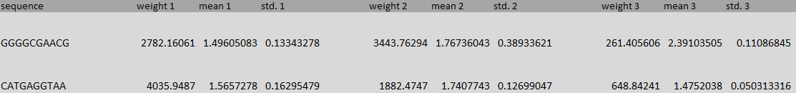
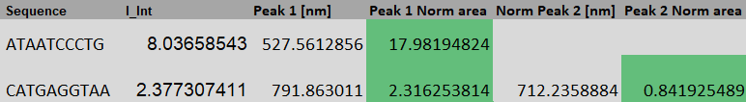
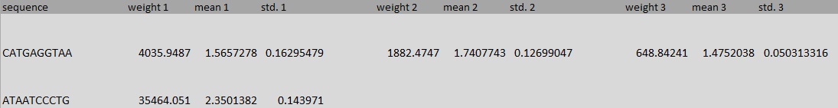
1
2
Cauchy-Schwarz Distance = 0.03367289
3
2
Cauchy-Schwarz Distance = 2.509010045

Slide 9
Clustering based on the CS-Distance

Slide 10
Spectral Clustering
We applied spectral clustering to the n×n distance matrix, which was calculated using the pairwise CS-distance function.
We tested a variety of cluster numbers, ranging from 8 to 50.
For evaluation, we used a qualitative method, employing the mean and weight of the sequences in each cluster (based on the Wavelength) to measure the average of each cluster. Specifically, we used color classes as bins and visualized the weight in each bin for the cluster mean.
Note:
the weights are not normalized.
for CS-distance function, we used the gaussian fit based on the Energy.
for clustering evaluation, we used their corresponding wavelength and weight for each peak.

Slide 11
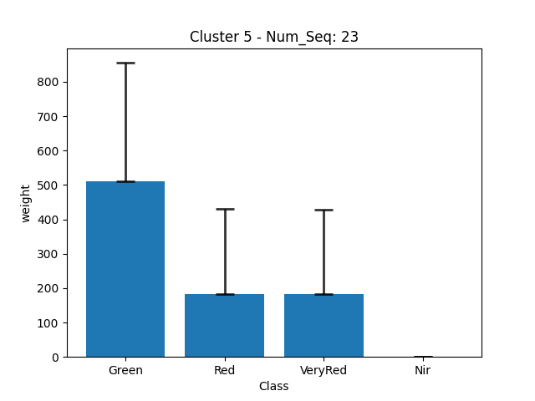
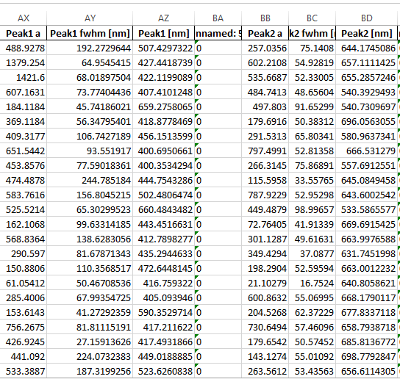
weight
STD
WAV
weight
STD
WAV
for instance, in this cluster we have 23 sequences and the mean of the cluster has higher weight in green class.

Slide 12
December 5, 2023

Slide 13
Clustering
We applied spectral clustering to the n×n distance matrix, which was calculated using the pairwise CS-distance function.
We tested a variety of cluster numbers, ranging from 3 to 15. and run K-Means multiple times
Note:
the weights are not normalized.
for CS-distance function, we used the gaussian fit based on the Energy.
for clustering evaluation, we used their corresponding wavelength and weight for each peak.

Slide 14
Evaluation
we used a qualitative method, employing the mean and weight of the sequences in each cluster (based on the Wavelength) to measure the average of each cluster. Specifically, we created m bins of wavelength and visualized the weight in each bin for the cluster mean.
Checking Intra-cluster distance: refers to the average distance between data points within the same cluster.
Checking Inter-cluster distance: distance between the centroids (mean or center points) of the clusters in different clusters.
sum the intra cluster, take the log, document about delta, how to add supervision to diffusion?

Slide 15
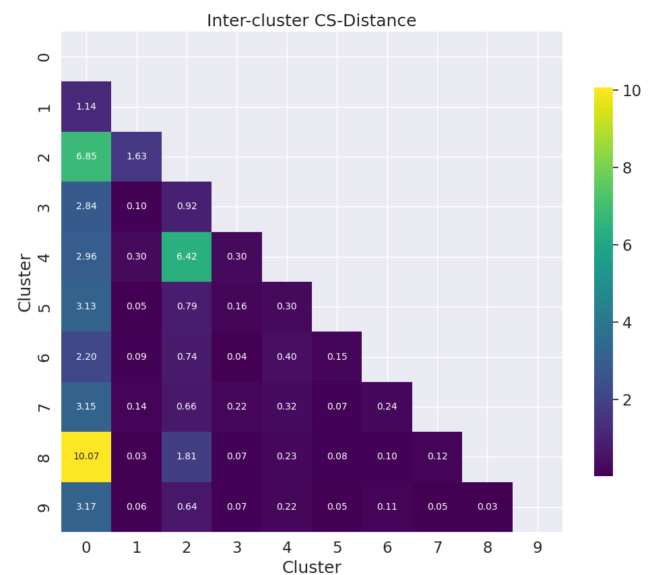
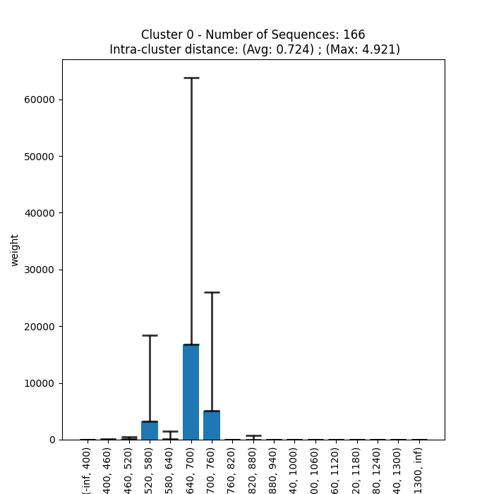

Slide 16
December 28, 2023

Slide 17
GMM dataset
We took the log of weights (the coefficients of each component of the GMM) and then calculated the CS-distance.
For applying spectral clustering, we used a 'precomputed' setup for the affinity matrix. However, as we have the distance, we must transform it into a similarity matrix. So, we applied a Gaussian kernel to the distance matrix:
exp(-dist_matrix ** 2 / (2. * delta ** 2))
Here, delta is a free parameter representing the width of the Gaussian kernel. (delta= 0.01)

Slide 18
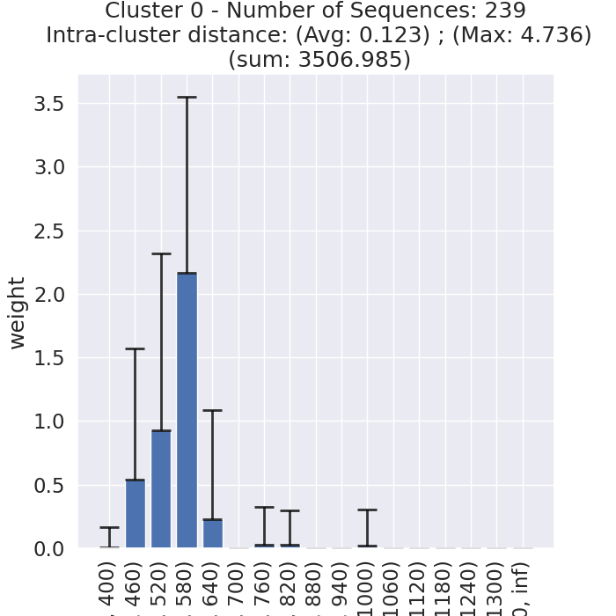
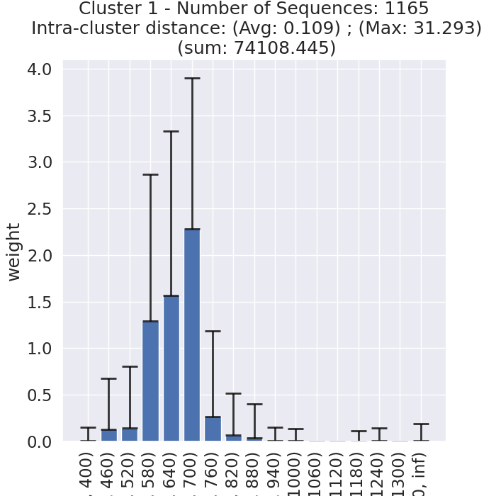
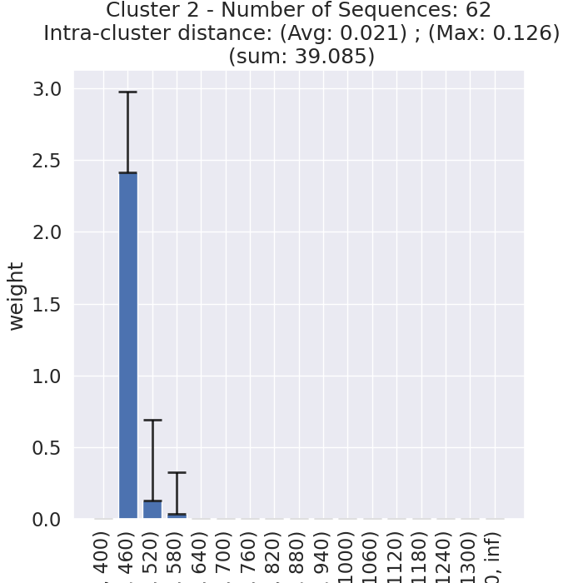
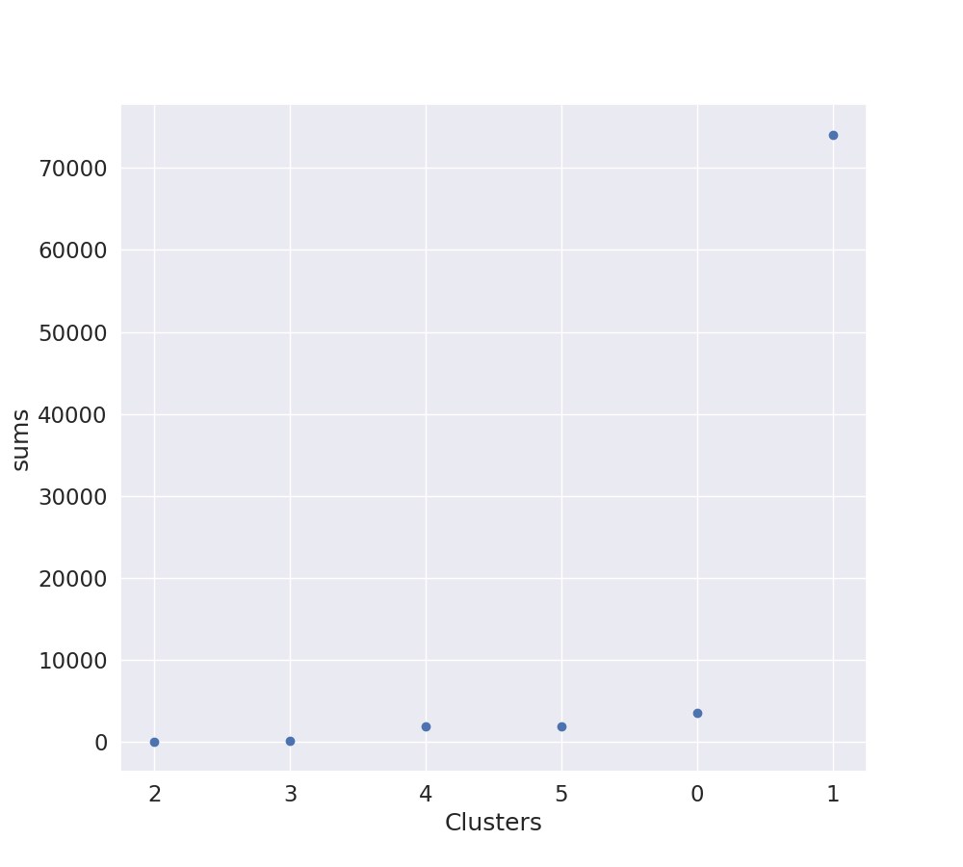
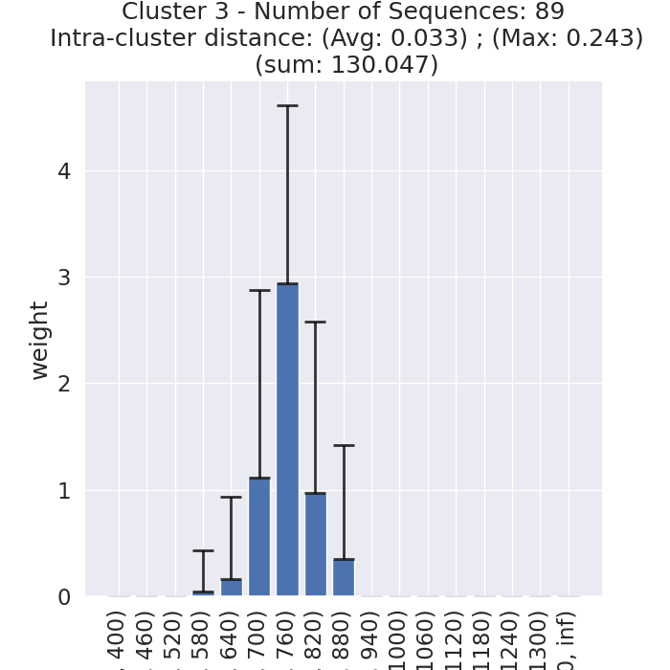
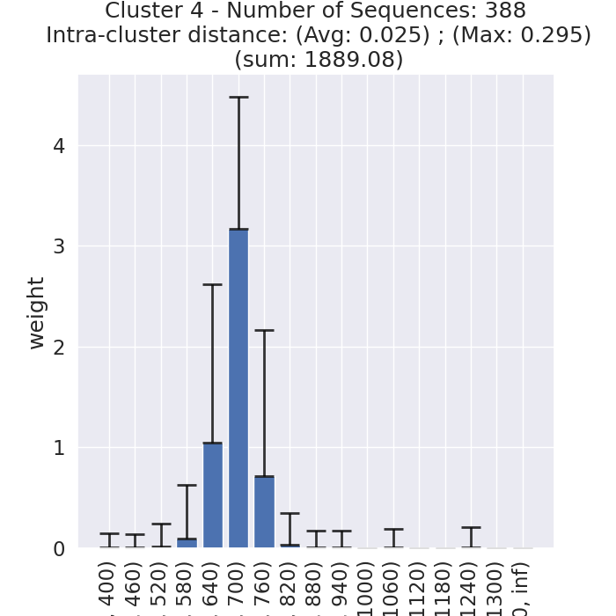
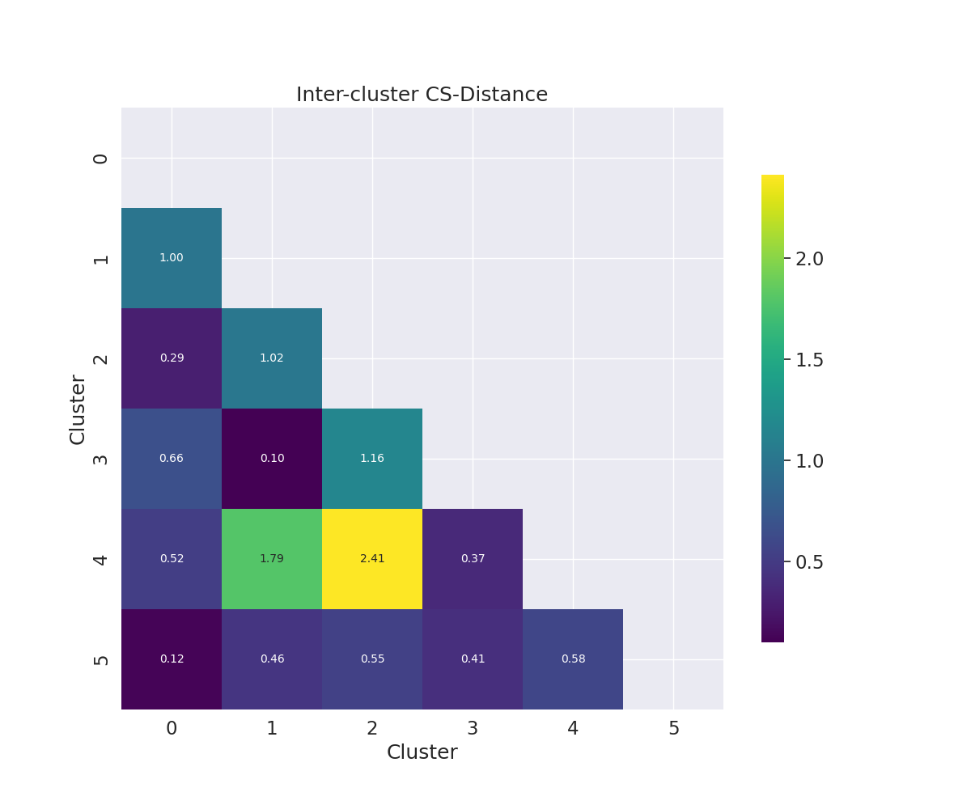
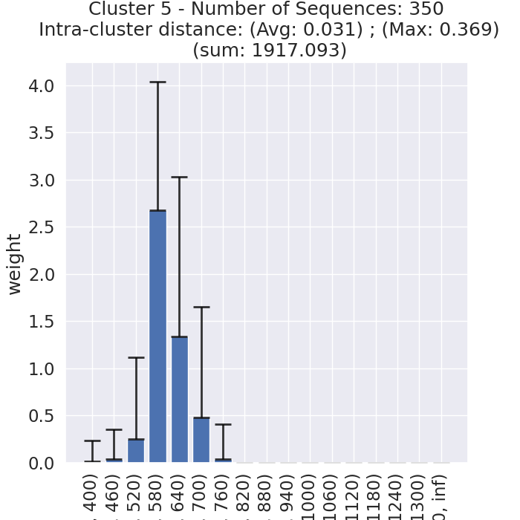
clusters

Slide 19
January 18, 2024

Slide 20
GMM Dataset preprocess
The initial steps of the data preprocessing involved the integration of secondary peaks information of NIR sequences from the "230505_all_sequences.xlsx" file into the "230624_all_data_workup.xlsx" file, specifically the NIR Data sheet.
Then, I used the wavelength and LII to compute GMM components for the NIR peak, utilizing "NIR Int Scaled". Since some sequences have secondary peaks, these secondaries serve as the second or third components of the NIR GMM.
The coefficients (a) and standard deviation (c) of the GMM components were determined using the equation LII = a * c with c set as sqrt(2)*100.
Because we had previously calculated the Cauchy-Schwarz distance based on Energy, we decided to change wavelength to energy again. We used the formula E = hc/λ.

Slide 21
GMM dataset preprocess
E = h * c / (λ* 1e-9) # Using nanometers for wavelength
h = 6.626e-34 # Planck's constant in J·s
c = 3.0e8 # Speed of light in m/s
λ # wavelength in nm
Note: we took the logarithm (log10) of the coefficients (a).
The resulting GMM was then compiled into an Excel file for the four classes, named "All-sequences-GMM.xlsx".
The next phase involved the calculation of the pairwise Cauchy-Schwarz distance, followed by the clustering of the sequences.
For applying spectral clustering, we used a 'precomputed' setup for the affinity matrix. However, as we have the distance, we must transform it into a similarity matrix. This was achieved by applying a Gaussian kernel to the distance matrix using the formula: exp(-dist_matrix ** 2 / (2. * delta ** 2))
Here, delta is a free parameter representing the width of the Gaussian kernel. (delta= 0.01)

Slide 22
February 5, 2024

Slide 23

F-divergence
In probability theory, F-divergence is a certain type of function that measures the difference between two probability distributions P and Q. Many common divergences, such as KL-divergence, Hellinger distance, and total variation distance, are special cases of F-divergence.
The squared Hellinger distance between two multivariate normal distributions
P and Q is:

Slide 24
Note:
The Hellinger distance forms a bounded metrics, meaning that it takes values in between 0 and 1. In other words, it satisfies the property 0⩽H(P,Q)⩽1. When distance is 0 the two distributions are identical. The maximum distance 1 is achieved when the two probability distributions are furthest apart . The squared Hellinger distance is symmetric, meaning that it satisfies the property H(P,Q)=H(Q,P)
Hellinger distance is closely related to, although different from, the Bhattacharyya Coefficient. In contrast to the Bhattacharyya Coefficient, the Hellinger distance is a metric which fulfills the triangular inequality, making it easier to interpret and work with. As a result, the Hellinger distance is often used as a replacement for the Bhattacharyya Coefficient.

Slide 25
February 26, 2024

Slide 26
Data Preprocessing
Convert NIR wavelength to energy, which serves as the mean (b) for the Gaussian Mixture Model (GMM).
Calculate the GMM coefficient (a) using the formula LII=a×c, where c is the standard deviation of NIR, defined as c=SQRT(2)×100.
Apply log base 10 transformation to the GMM coefficients, similar to what is done for visible sequences.
Identify NIR sequences with secondary peaks in the visible dataset and incorporate their Gaussian fit values as additional components, potentially resulting in some sequences having up to 4 components.
Combine NIR Gaussian data without secondary peaks into the dataset to create a new Gaussian dataset encompassing all classes.
Note: There are 27 NIR sequences with secondary peaks, not included in the visible Gaussian fit dataset, all from plate14. Due to uncertainty in calculating the values for c for visible data, these 27 sequences have been temporarily excluded.

Slide 27
Clustering
Applied spectral clustering, identifying six clusters as the optimal number.
Used these clusters for batch stratification and evaluating the VAE model.

Slide 28
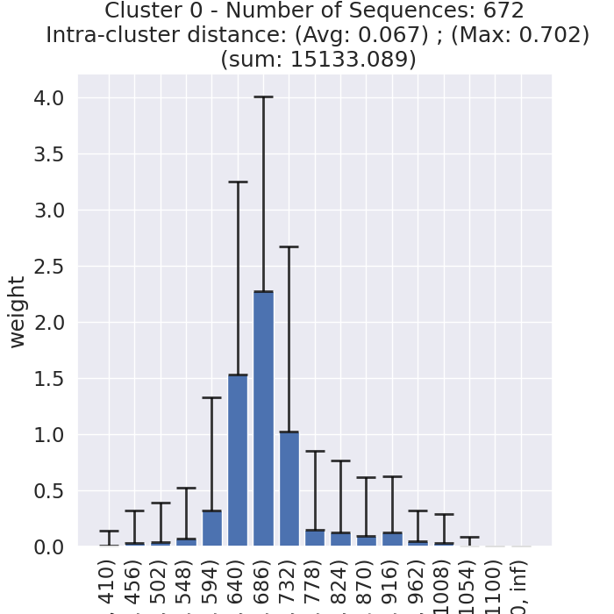
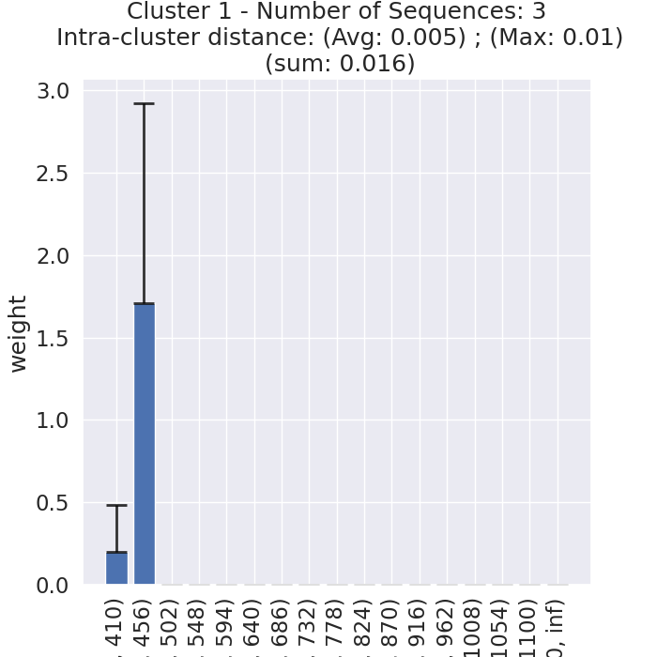
Clusters
Red-FarRed
# Sequences: 672
Green
# Sequences: 8

Slide 29
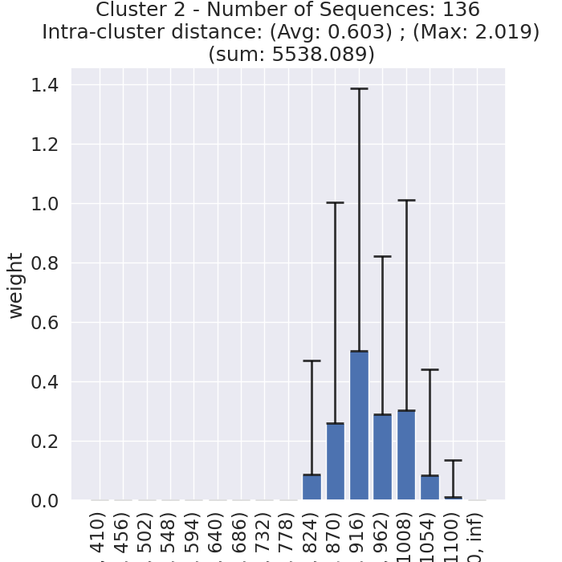
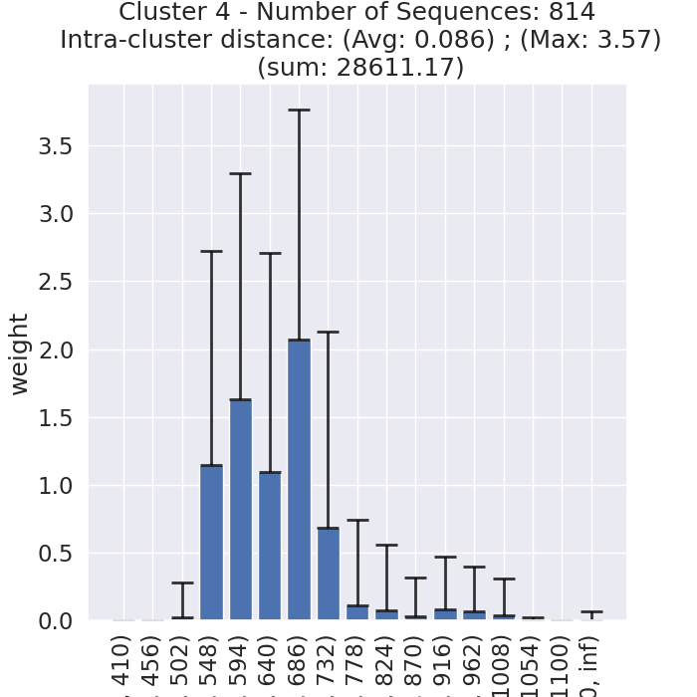
Clusters
NIR
# Sequences: 136
Green-Red
# Sequences: 814

Slide 30
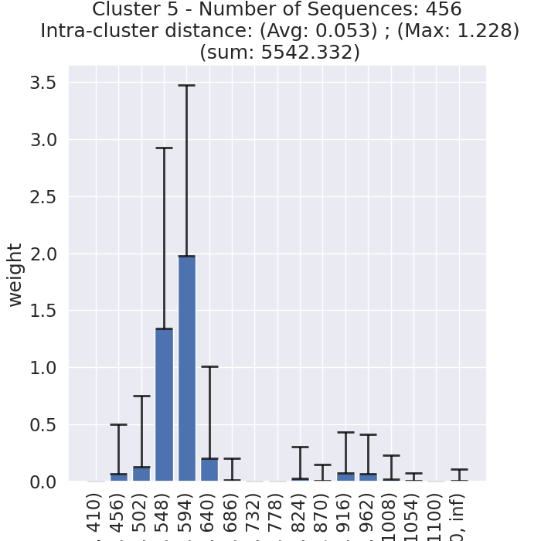
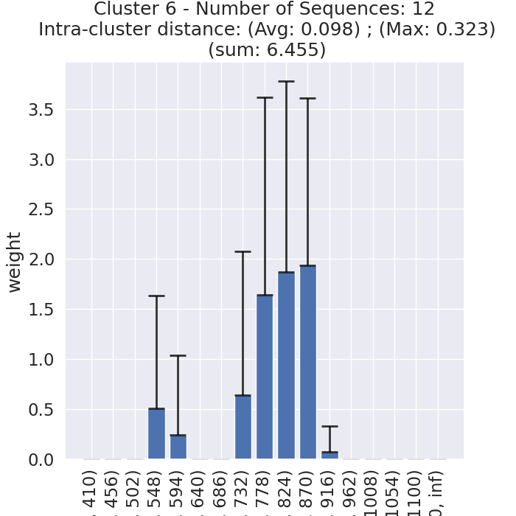
Clusters
Green-NIR
# Sequences: 456
Green-FarRed
# Sequences: 12

Slide 31
Correlation
Original Space:
For each pair of clusters (i, j) in the original space:
Initialize distancesOriginal list
Compute CS-distance between samples a in cluster i and samples b in cluster j
Calculate mean of distancesOriginal
Assign mean to matrixOriginal[i][j] and matrixOriginal[j][i]
Latent Space:
For each pair of clusters (i, j) in the latent space, do the same but use the latent code and Euclidean distance to achieve matrixLatent.
Compute Correlation:
Compute correlation between matrixOriginal and matrixLatent to preserve geometry.
Note: As the matrices are symmetric, we calculate the upper triangle correlation.

Slide 32
April, 2024

Slide 33
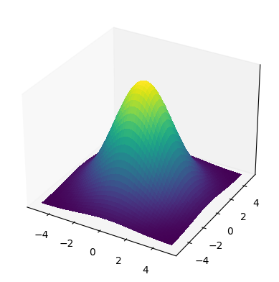



Model architecture and data flow overview
D_{cs} = S(i) - S(j)
D_{z} = Z(i) - Z (j)
Pair-wise
Distance
Align
Pair-wise
Distance
Cauchy–Schwarz Distance Function
n×n
n×n
Euclidean Distance Function
Spectra
Training
Sequences
Latent Space
Training Data Distribution in Joint Space
Designed
Sequences
AACACGAGAT
GGACCGGACC
GAGGTCGTCA
CCCCGAAGTT
.
.
.
GGGGCCCGGT
AAAAGATGTT
AACCCCTCCA
CCTGGGGGGT
AAACCGGAGC
AGCCGAAGTT
.
.
.
CAACGGGTCG
CCTGGGGGGT
AAACCGGAGC
AGCCGAAGTT
.
.
.
CAACGGGTCG
Encoder
Decoder
Encoder
$$µ$$
$$µ$$
Rank
$$σ$$
$$σ$$
Sample
Wet Lab Validation

Slide 34
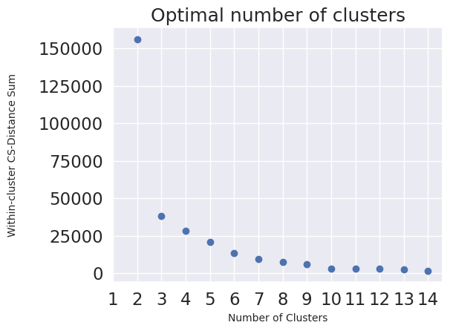
Evaluation
D_{cs} = S(i) - S(j)
Pair-wise
Distance
Gaussian Kernel
Similarity
Spectral Clustering
Optimal Number of Clusters
n×n
n×n
Across-Cluster Distance
D_{z} = Z(i) - Z (j)
Pair-wise
Distance
Across-Cluster Distance
Correlation (Geometry Preserving)
6×6
6×6
n×n

Slide 35
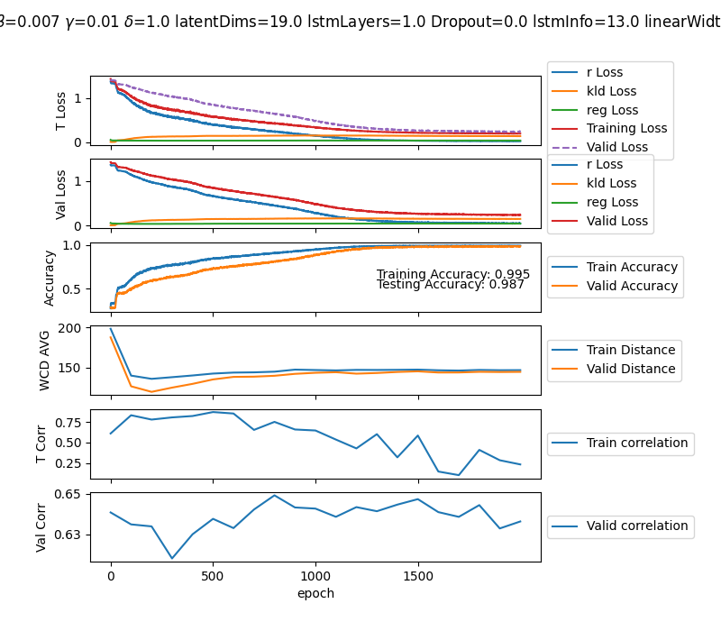
Gamma= 0.01
The model cannot maintain the balance between r-loss and reg-loss.
Using a small gamma value, close to 0, leads to good accuracy.
However, because the impact of regularization is very low, the correlation drops significantly as the accuracy reaches a higher value

Slide 36
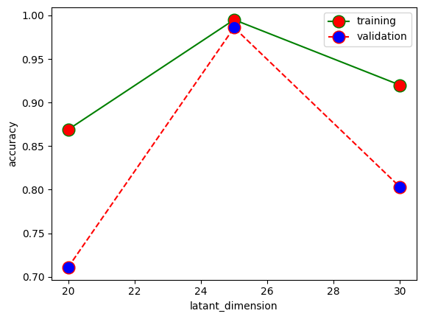




Grid Search
Gamma: 0.08
Hidden:15
Delta: 1
Gamma: 0.7
Hidden:15
Delta: 1
Latent dimension: 25
Hidden:15
Delta: 1 (scaling parameter)
$L_{VAE}$ = $L_{REC}$(φ, θ) + ${\text{β} L}_{KL}$(φ, θ) + γ $L_{REG}$
$L_{REG}$= MAE( $D_{z}$ – δ$D_{CS}$)

Slide 37





Grid Search (cont’d)
Gamma: 0.08
Hidden:15
Latent dimension: 25
Gamma: 0.7
Hidden:15
Latent dimension: 25
Gamma: 0.08
Delta: 1
Latent dimension: 25
Gamma: 0.7
Delta: 1
Latent dimension: 25
Gamma: 0.7
Hidden: 20
Latent dimension: 25

Slide 38

Best model so far
Latent dimension: 25
Hidden:15
Delta: 1
Gamma: 0.08

Slide 39

Second model
Latent dimension: 25
Hidden:20
Delta: 1
Gamma: 0.7

Slide 40

Gamma= 0.01
Latent dimension=30

Slide 41

Gamma= 2
Latent dimension=30

Slide 42
May, 2024

Slide 43

Gamma= 2
Latent dimension=32
LSTM layers= 2
Dropout= 0.2
Hidden= 16
Correlation bug is fixed, but the model is over fitted, accuracy is low.
According to my experiments, we might need complex network, as when I increased the number of LSTM layers, I found better results.

Slide 44

Gamma= 2
Latent dimension=32
LSTM layers= 1
Dropout= 0
Hidden= 16
My plan:
Increase batch size to 64, as larger batch size generally provides more stable and accurate estimates of the gradient.
With a larger batch size, the model may converge more smoothly, although potentially requiring more epochs to reach the same level of accuracy as with smaller batches.

